Slide 1

KARTHIK NAIR
December 3rd, 2024
FILIP TOMOVSKI
DS5110
CUSTOMER
BEHAVIOR DASHBOARD

Slide 2
PROJECT OVERVIEW
Objective: Develop a dashboard to support data-driven decision-making.
Customer behavior
Sales trends
Demographics
Scope:
Data collection and processing (sales, customer demographics, holiday trends)
Pipeline & Database design
Dashboard development (User friendly design)
Key Features:
Sales analysis
Holiday insights
Geographical mapping (highlight customer density and geographical trends)
Performance metrics (revenue, averages)

Slide 3
MOTIVATION AND IMPORTANCE
Why?
Businesses rely on data-driven decisions
Currently lacking interactive solutions
External factors can enhance sales trends
How?
Marketing strategies
Inventory management
Who are the customers
When do sales peak

Slide 4
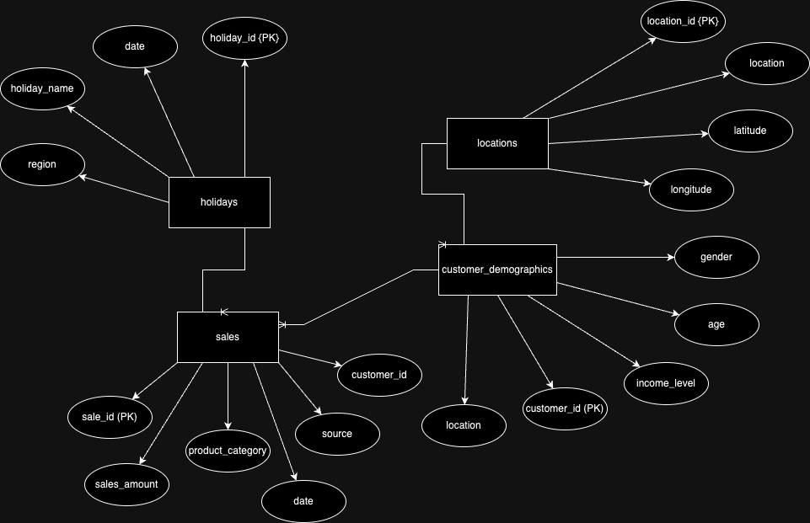
DATA SOURCES

Slide 5
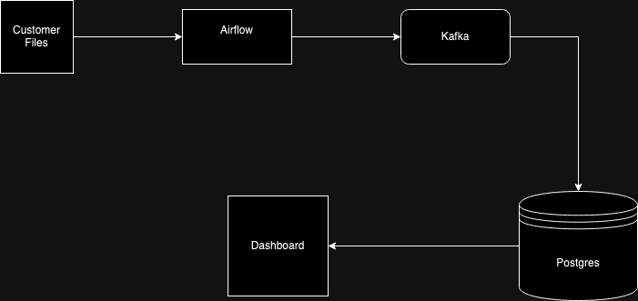
SYSTEM ARCHITECTURE

Slide 6
BACKEND DEMO

Slide 7
DASHBOARD DEMO

Slide 8
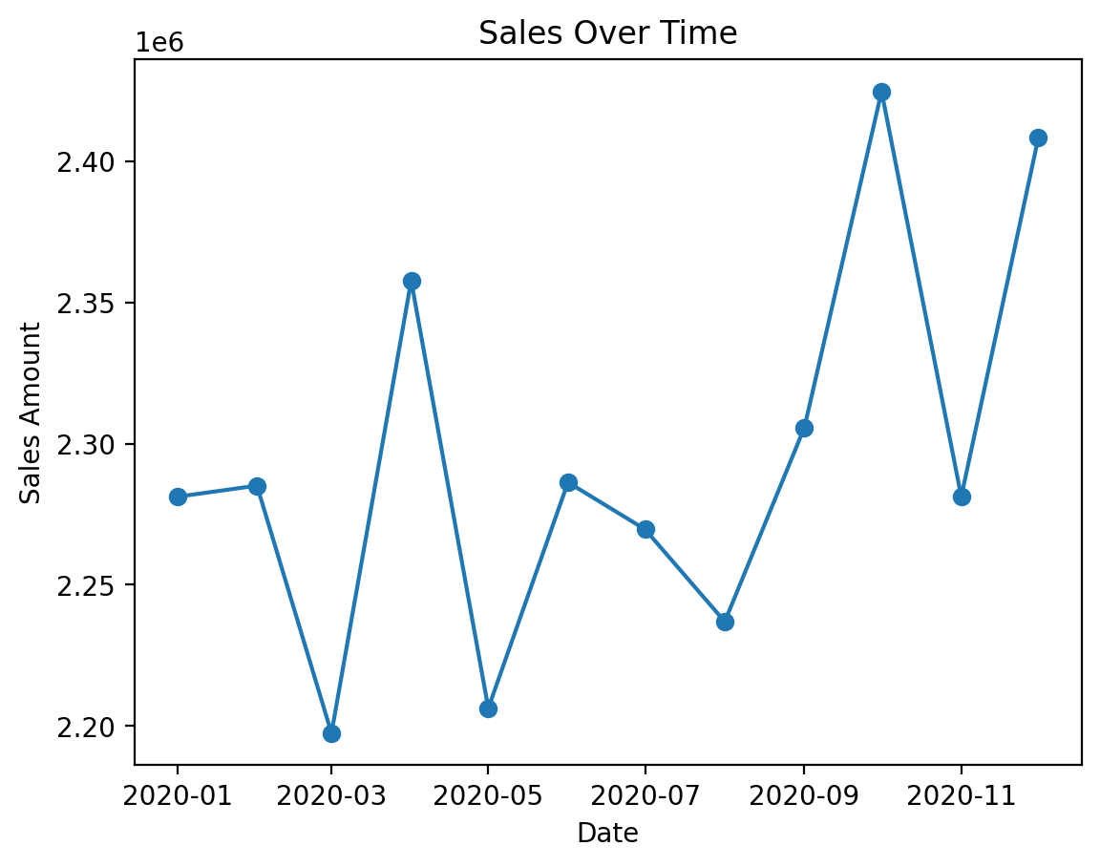
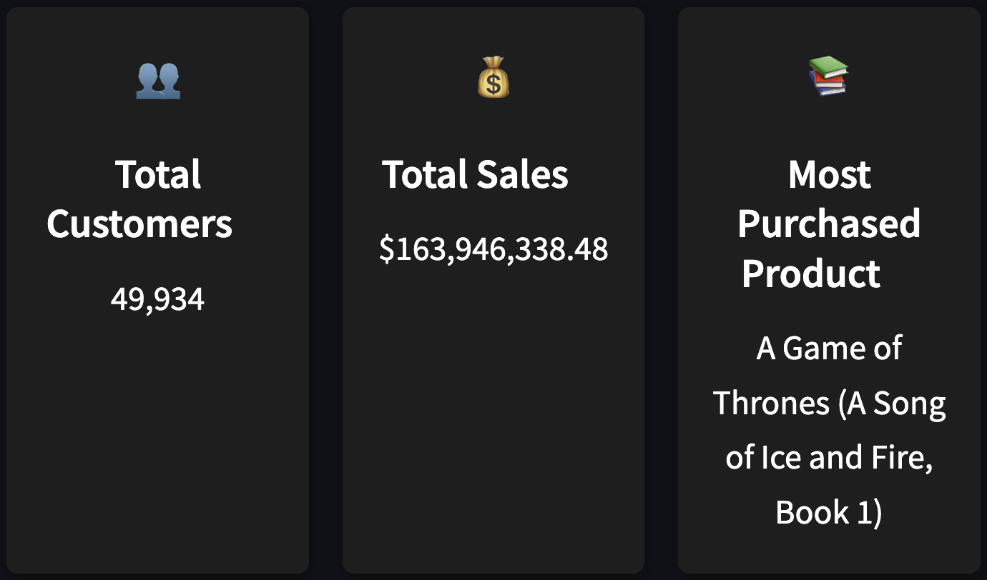
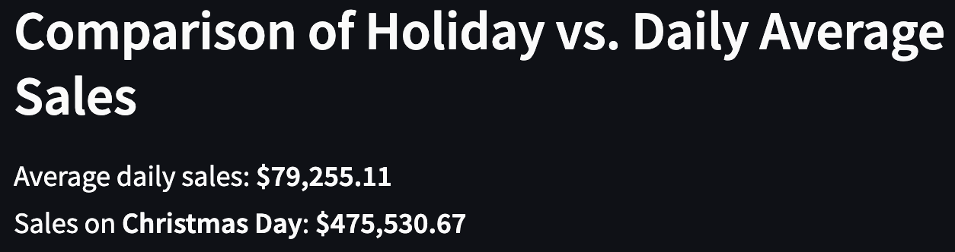
KEY FINDINGS

Slide 9

THANK YOU

